Slide 1
Trending apps detection Client: N3twork
Team members
Kate Mizgireva (Data Science, MUSC Data Science Research Intern)
Katie Balcewicz (Data Science, Office of Admissions Student Data Model Builder)
Zach Kidd (Data Science)

Slide 2
Project description
Web-scrape data from Apple and Android App Stores on top 500 trending gaming apps
Upload into MongoDB and process the data
Implement daily Bash scripts to collect the data
Detect the outliers in trends
Build predictive model on apps that will trend in future
Implement a script to send a daily e-mail to the company with the list of apps worth checking

Slide 3










Technologies Used
repository, scrum management communication, updates, tracking database
storage, hosting virtual machine web scraping
daily scripts main scripts predictive modeling data collections

Slide 4

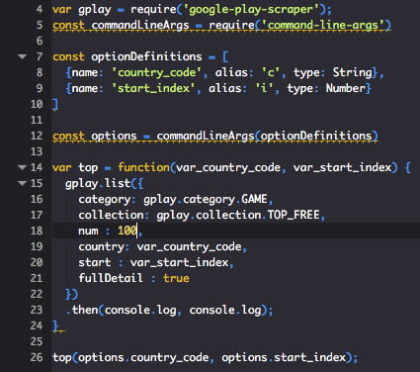
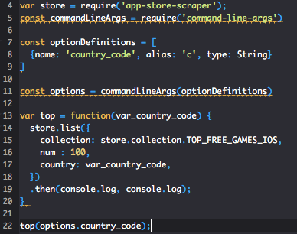
TECHNOLOGIES

Slide 5
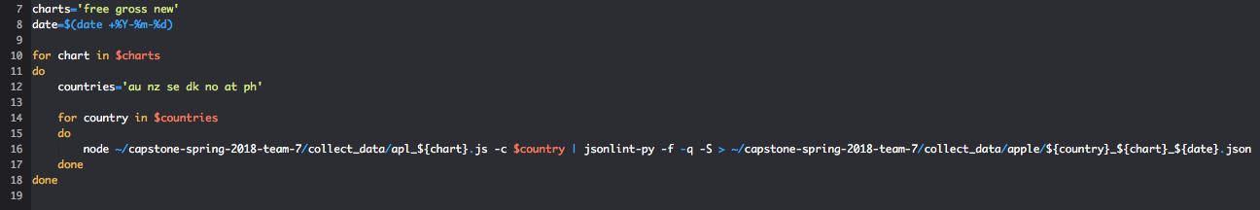
TECHNOLOGIES

Slide 6
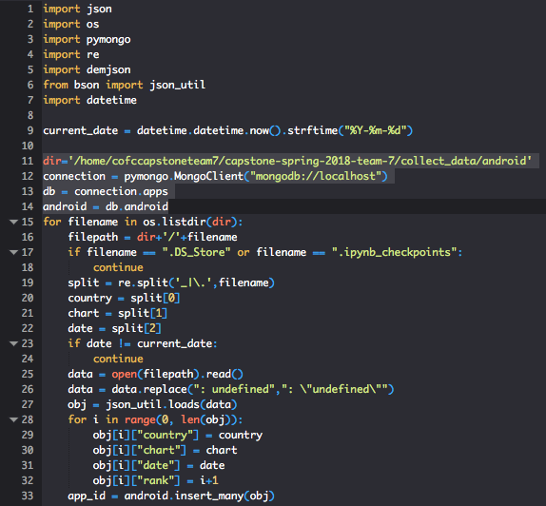
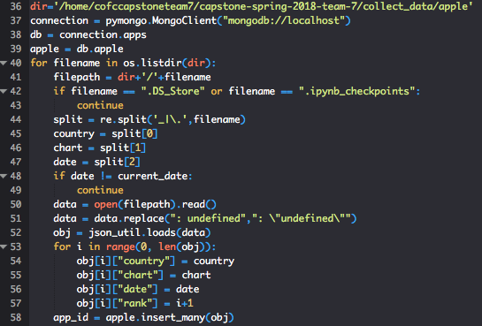
TECHNOLOGIES

Slide 7
the Semester-long Scrum Process
The Project was divided into 3 Sprints:
Sprint 1: web Scrapping and putting the data into database
Sprint 2: prepare data and build predictive models
Sprint 3: final touch ups. Script the e-mail (final deliverable)

Slide 8
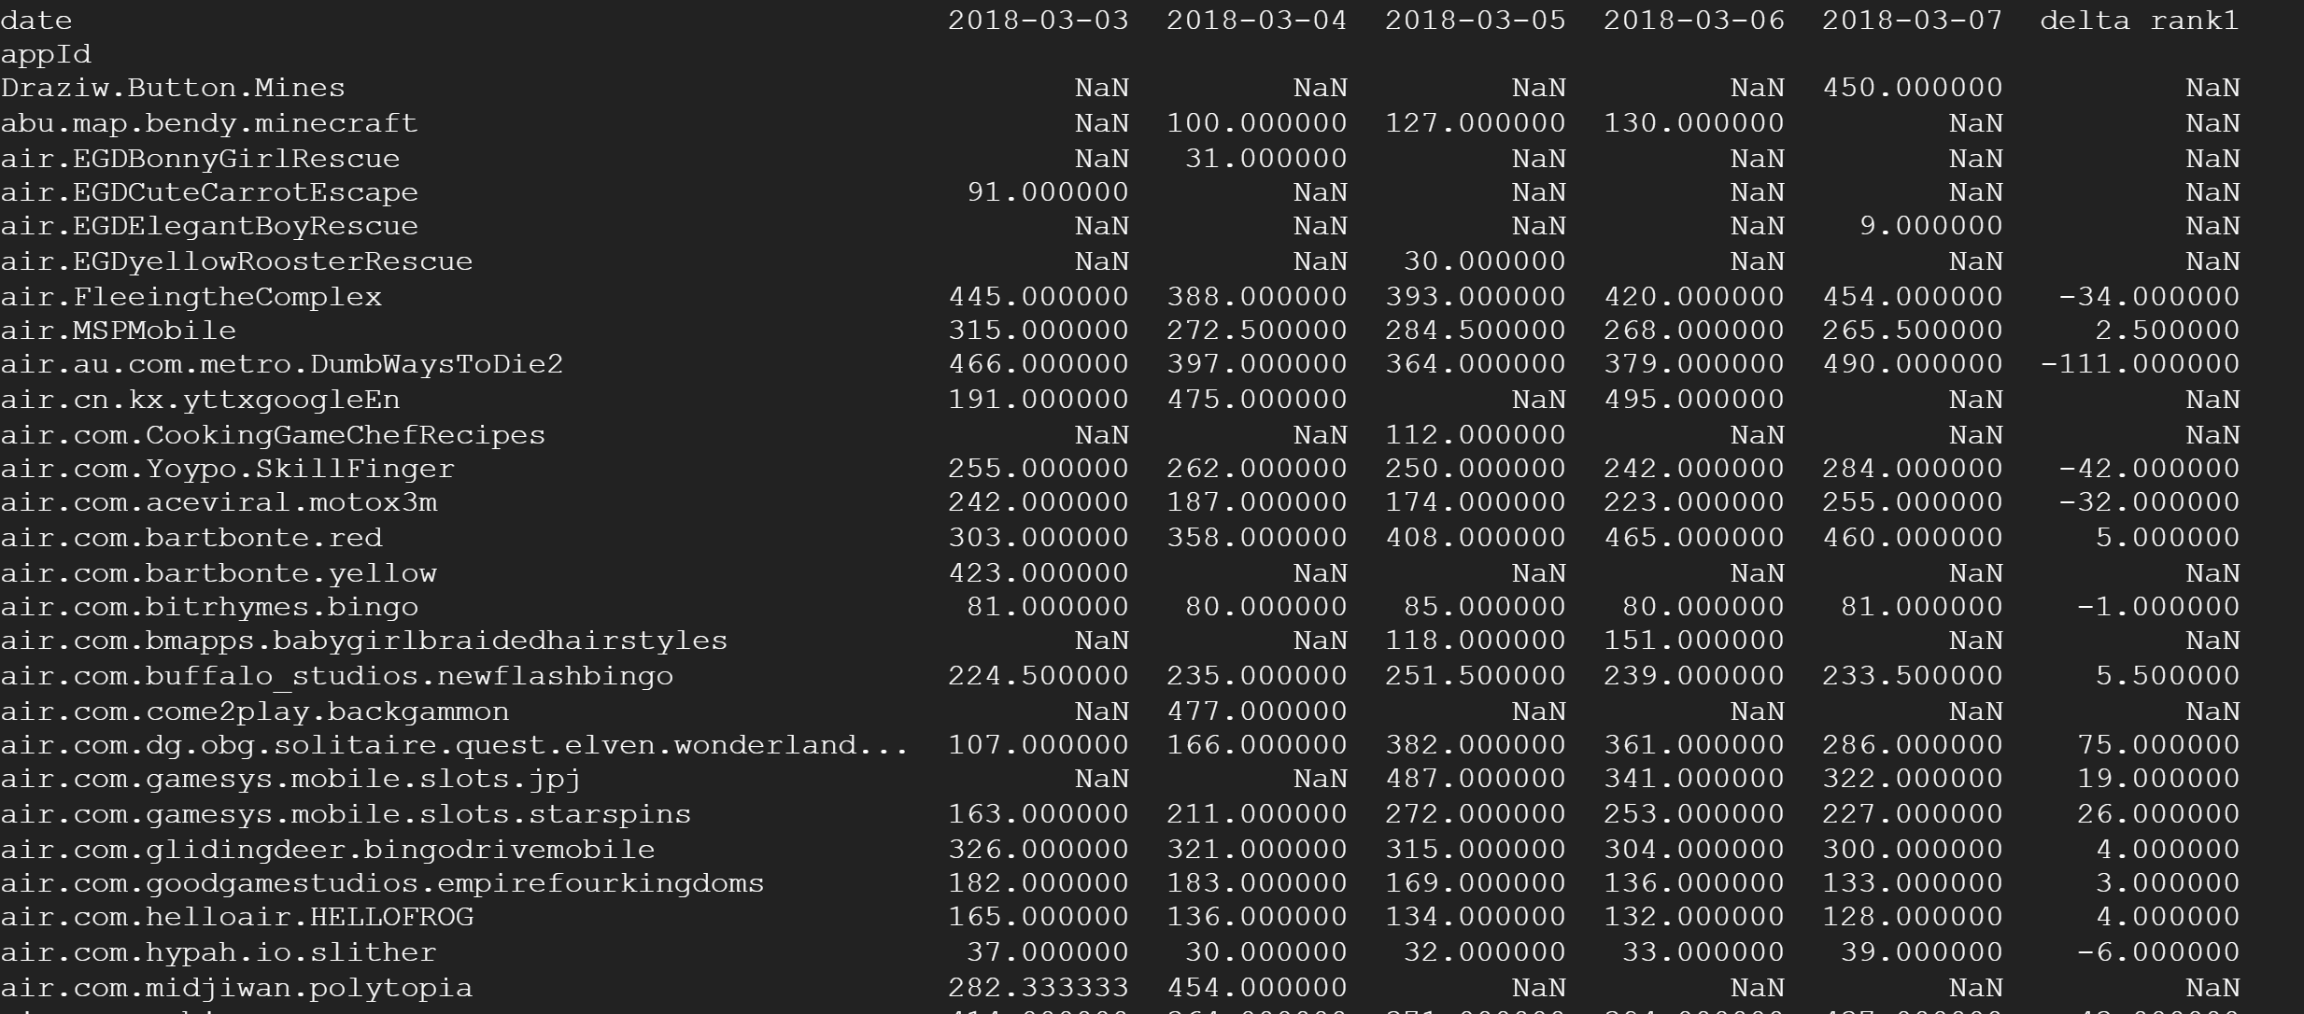
More details about the project

Slide 9
Challenges and triumphs
Katie’s issue with json files
Learned Node.js
Google Cloud storage space

Slide 10
Live demo of current state of the software
This is super important…. So, be sure not to break your code before presentation day. Fork often so that you have backups of working versions of the project.
Make sure for the mid-term, and especially the final presentation, you have a working live demo.
Your presentation ends with the live demo and afterwards you can ask the audience for questions.

